Slide 1
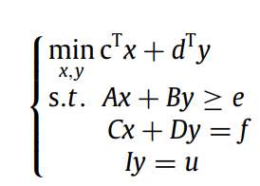
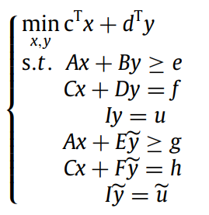
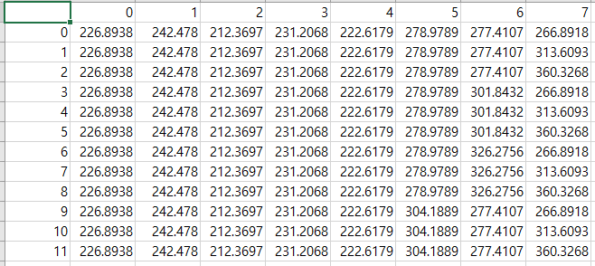
P2H Microgrid Stochastic Optimization
Stage-A : Optimization about resources in MG
Get each resources Power about each hours
(ESS -> Charge/Discharge
Fuel cell(Hydrogen), Fuel cell(LNG) -> Generator
EL -> Active load(But it optimized power))
Stochastic predict demand power
Time | Load +PV | ESS power | ESS SoC | LNG TOU | LNG Power | FC TOU | FC power | EL power | Net Load
0 | 15.16368 | 0 | 50 | 10 | 2.5 | 60 | 2.5 | 0 | 10.16368
1 | 12.96125 | 0 | 50 | 10 | 5 | 60 | 5 | 0 | 2.961247
2 | 11.52231 | 0 | 50 | 10 | 5 | 60 | 5 | 0 | 1.522311
3 | 10.76252 | 0 | 50 | 10 | 5 | 60 | 5 | 0 | 0.76252
4 | 10.31347 | 0 | 50 | 10 | 5 | 60 | 5 | 0 | 0.313473
Create Scenario using Markov Chain
24 H
24 H
Example output optimization
(Don’t care about number)
400 Scenario

Slide 2
Stage B: Calculate Voltage
Define the P and Q values of MG internal resources (house, ESS FC, EL) through the optimization of Stage A
Based on Stage A output, we need to calculate the voltage value of the rear part of Bus1 and the rear part of Bus2
If a situation occurs where the voltage error range exceeds 10%, I am thinking of recalculating the optimization of Stage A.
This line is not electric wire
? V
? V
? V

